Slide 1
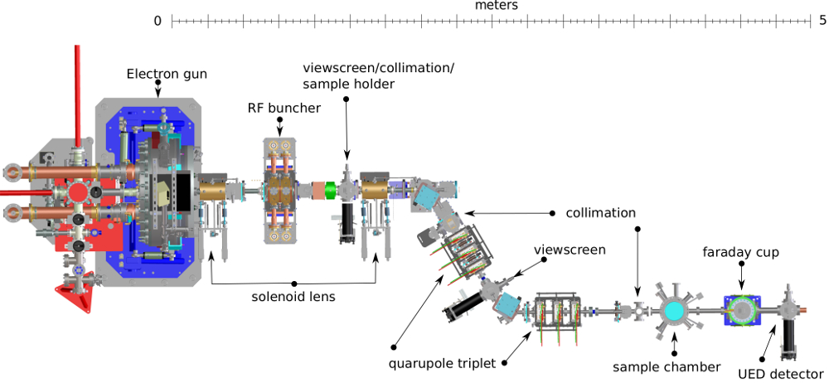
2nd Round of ML applied to HiRES:
Energy Stability
ANTONIO GILARDI
09/12/2021

Slide 2

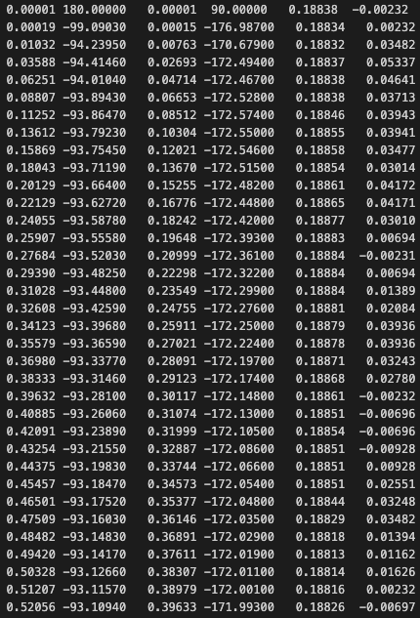
Laser question
Data Structure:
- FileName
- FileName.rf.dat
Loss-Less
In-loop Magnitude
In-loop Phase,
OOL Magnitude,
OOL Phase,
Laser Amplitude,
Laser Phase
- FileName.ucam1
- FileName.rf
- FileName.ucam1.dat
- FileName.rf.dat
- FileName.ucam1.dat.post
- FileName.rf.dat.post
- FileName.rf.dat.post
>> x_cav_main = x[:,0]
>> x_cavp_main = x[:,1]
>> x_cav_aux = x[:,2]
>> x_cavp_aux = x[:,3]
>> x_egain_main = x_cav_main*np.cos(x_cavp_main*np.pi/180.0)
>> x_egain_aux = x_cav_aux*np.cos((x_cavp_aux+79.0)*np.pi/180.0)
win = int(100e-6/ dt) <<
win_start = int(580e-6 / dt) <<
wsp = 4 <<
dt = wsp*22/(102.14e6) <<
x_laser_amp = x[:,4] # 4 - Laser AMP <<
x_laser_phs = x[:,5] # 5 - Laser PHS <<
x_laser_amp_avg = np.mean(x_laser_amp[:,win_start:win_start+win], axis=1) <<
x_laser_phs_avg = np.mean(x_laser_phs[:,win_start:win_start+win], axis=1) <<
x_laser_amp_ac = (x_laser_amp_avg-np.mean(x_laser_amp_avg))/np.mean(x_laser_amp_avg) <<
x_laser_phs_ac = (x_laser_phs_avg-np.mean(x_laser_phs_avg))/np.mean(x_laser_phs_avg) <<

Slide 3
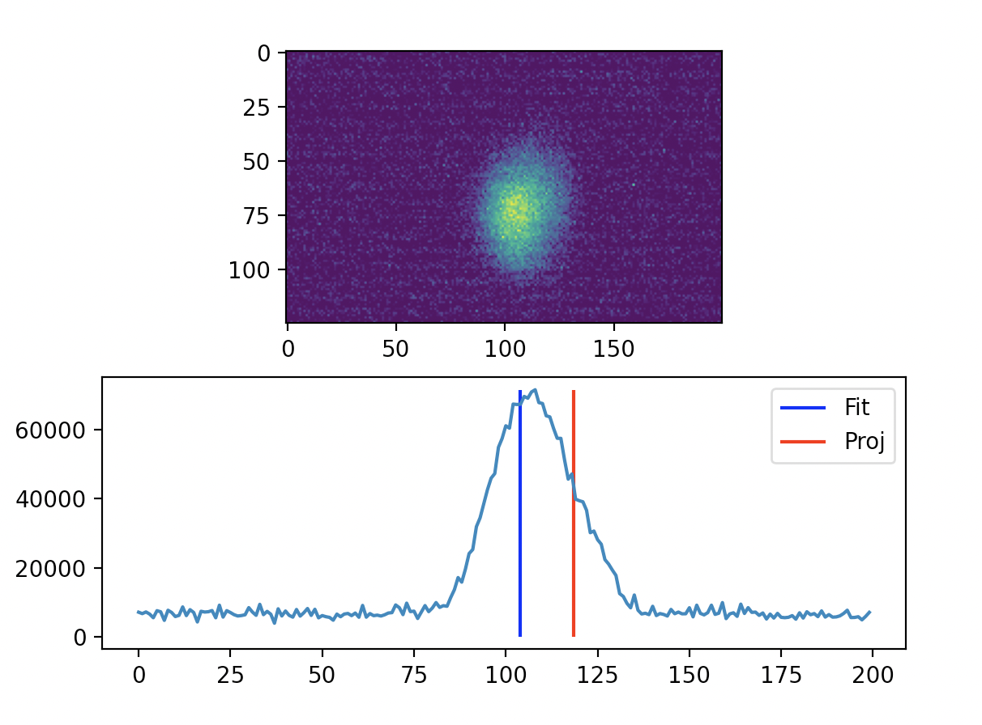
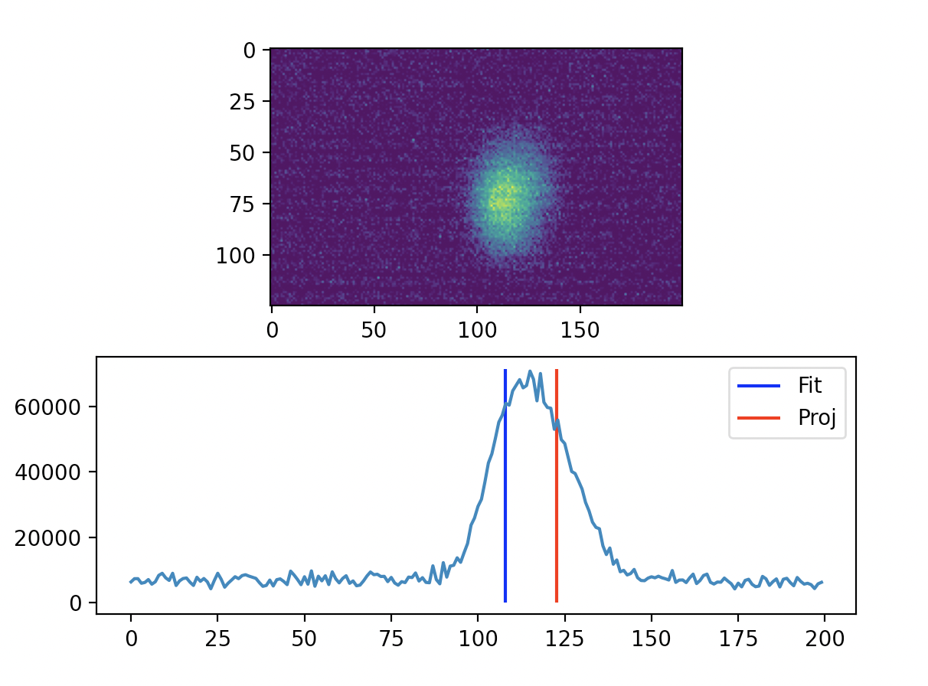
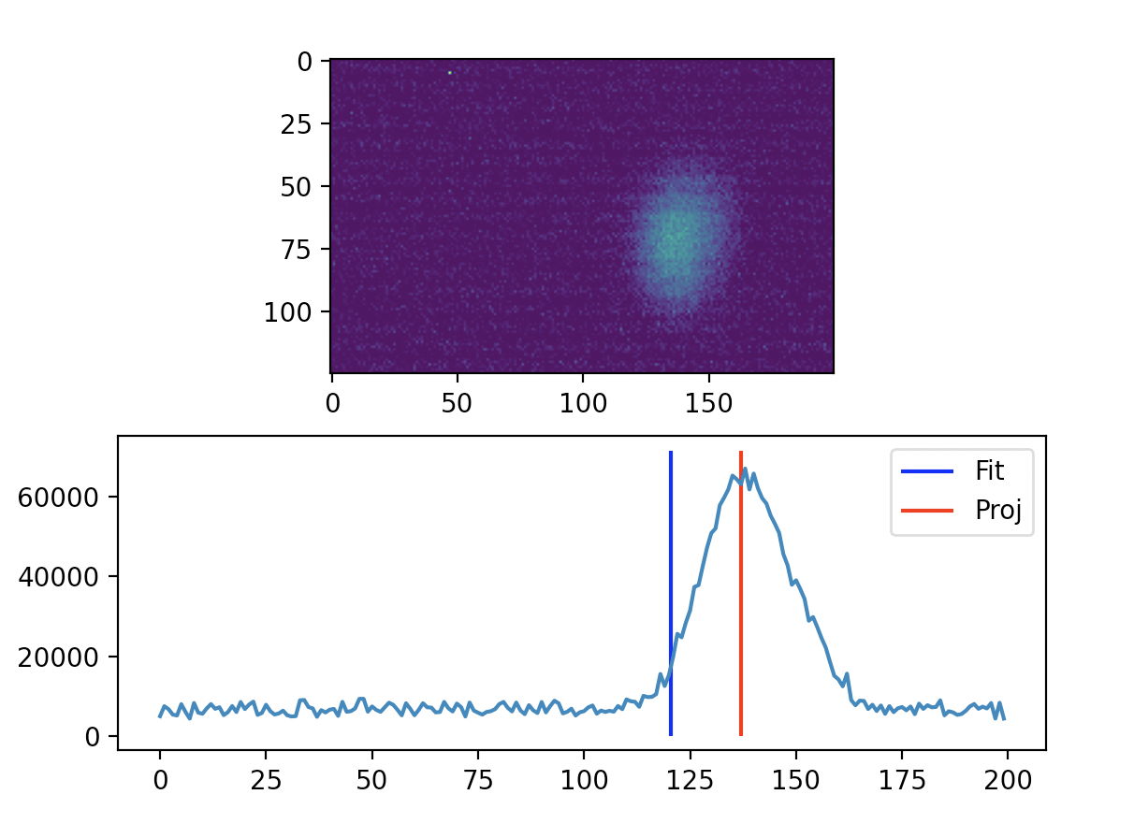
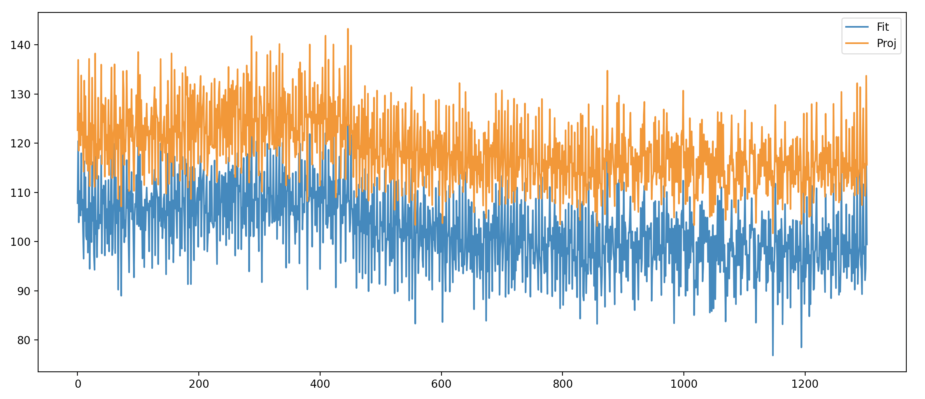
Camera Processing
X → Projected image
>> pX = x / np.sum(x)
>> CentroidProjection[i] = np.sum( x * pX)

Slide 4
Dataset used
- Open loop capture:
- 20m0s capture: OK (sync_acq_wsp4_5ch_1hz_ucam1_lcam1_long)
- Buncher off
- 7818 / 3x2 = 1303 RF buffers
- 1303 ucam buffers
- Close loop capture:
- 20m0s capture: OK (sync_acq_wsp4_5ch_1hz_ucam1_lcam1_cloop_long)
- Buncher off
- 7818 / 6 = 1303 RF buffers
- 1303 ucam buffers
>> camFit = np.load("data/"+InOrOut+"/CameraFit.npy")
>> camProj = np.load("data/"+InOrOut+"/CameraProj.npy")
>> OL_phs = np.load("data/"+InOrOut+"/OL_Phase.npy")
>> OL_amp = np.load("data/"+InOrOut+"/OL_Magnitude.npy")
>> ILmOL_phs = np.load("data/"+InOrOut+"/OL_Phase.npy") - np.load("data/"+InOrOut+"/IL_Phase.npy")
>> ILmOL_amp = np.load("data/"+InOrOut+"/OL_Magnitude.npy") - np.load("data/"+InOrOut+"/IL_Magnitude.npy")
>> laser_Phs = np.load("data/"+InOrOut+"/Laser_Phs.npy")
>>laser_amp = np.load("data/"+InOrOut+"/Laser_Amp.npy")

Slide 5
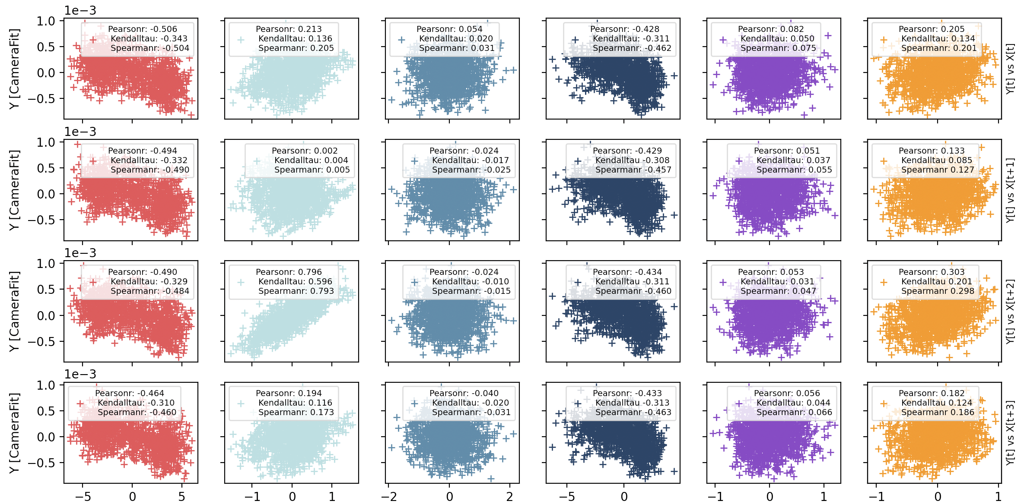
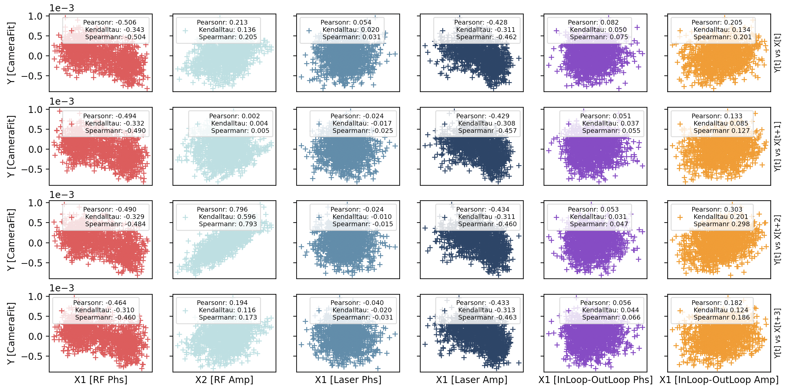
Feature selection
OUT OF LOOP -----------> No feedback stabilization

Slide 6
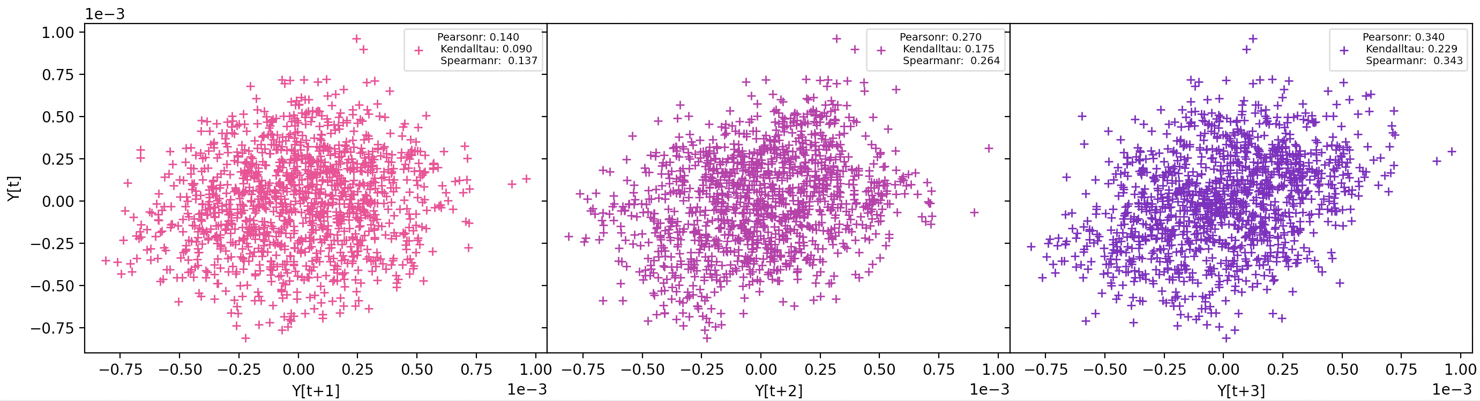
Feature selection
OUT OF LOOP -----------> No feedback stabilization
Stronger correlation with t+2
To be surely considered are:
RF amp
RF phs
Laser amp

Slide 7
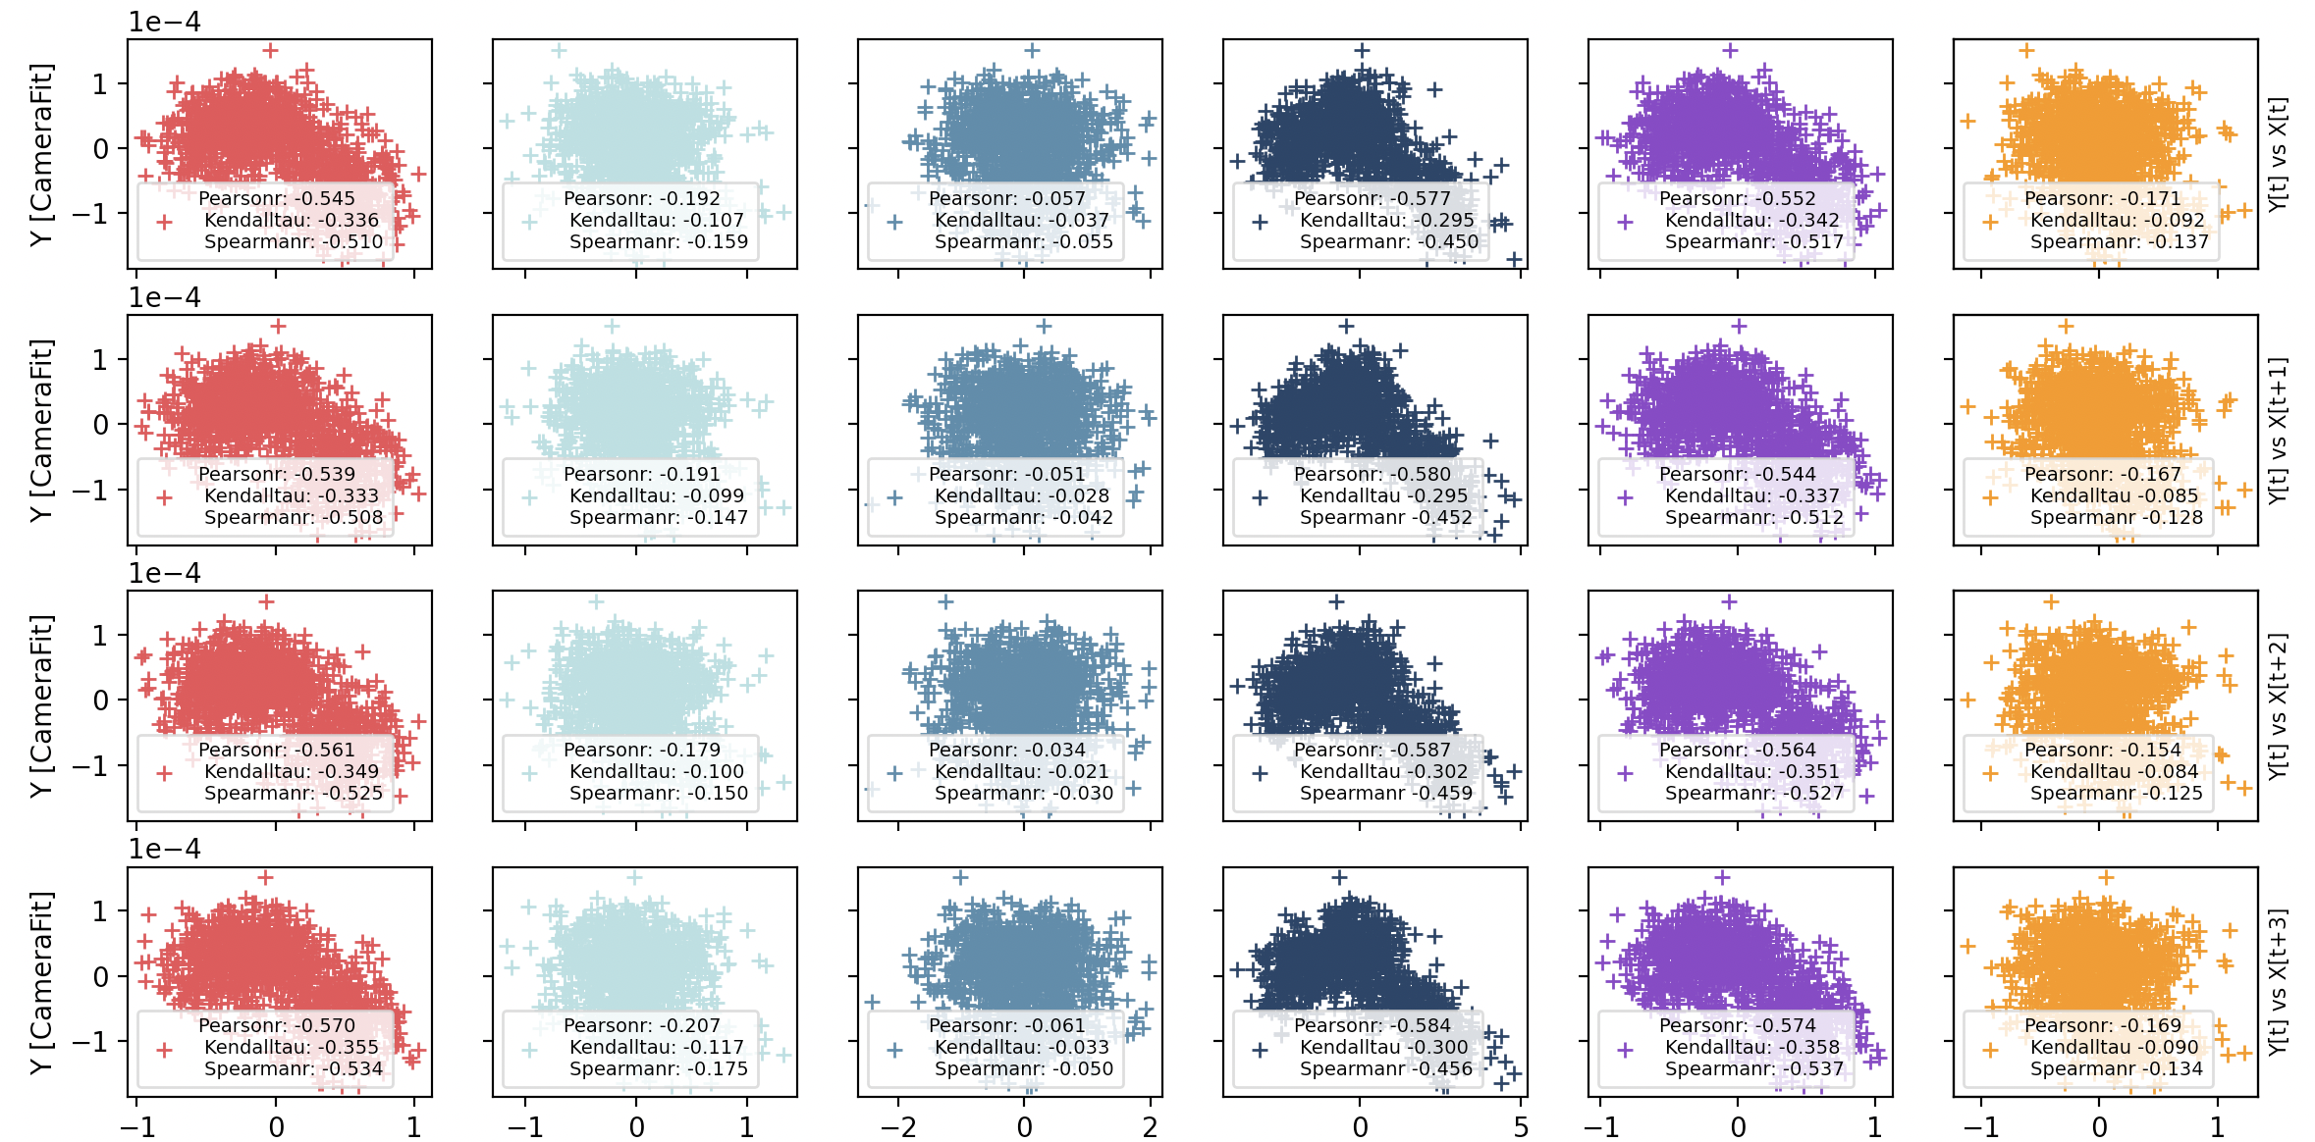
Feature selection
IN LOOP -----------> Feedback stabilization

Slide 8
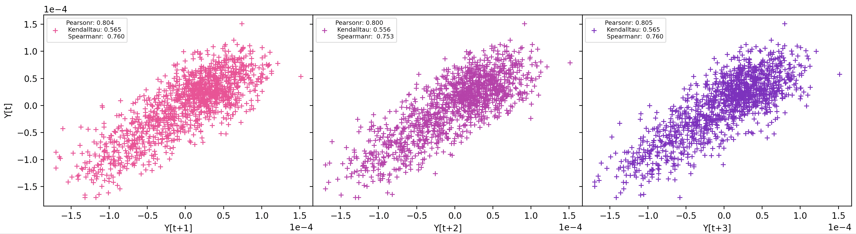
Feature selection
IN LOOP -----------> Feedback stabilization

Slide 9
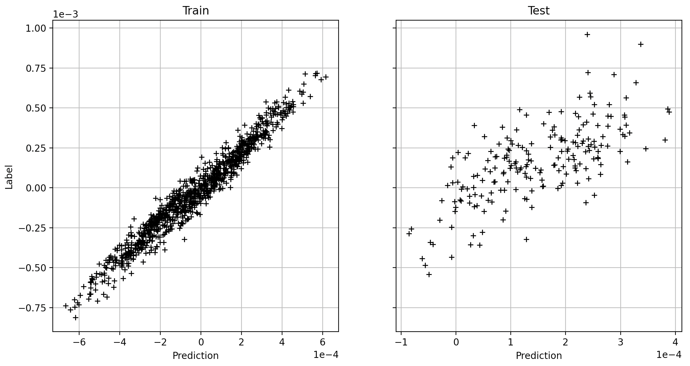
Results
OUT OF LOOP -----------> No feedback stabilization

Slide 10
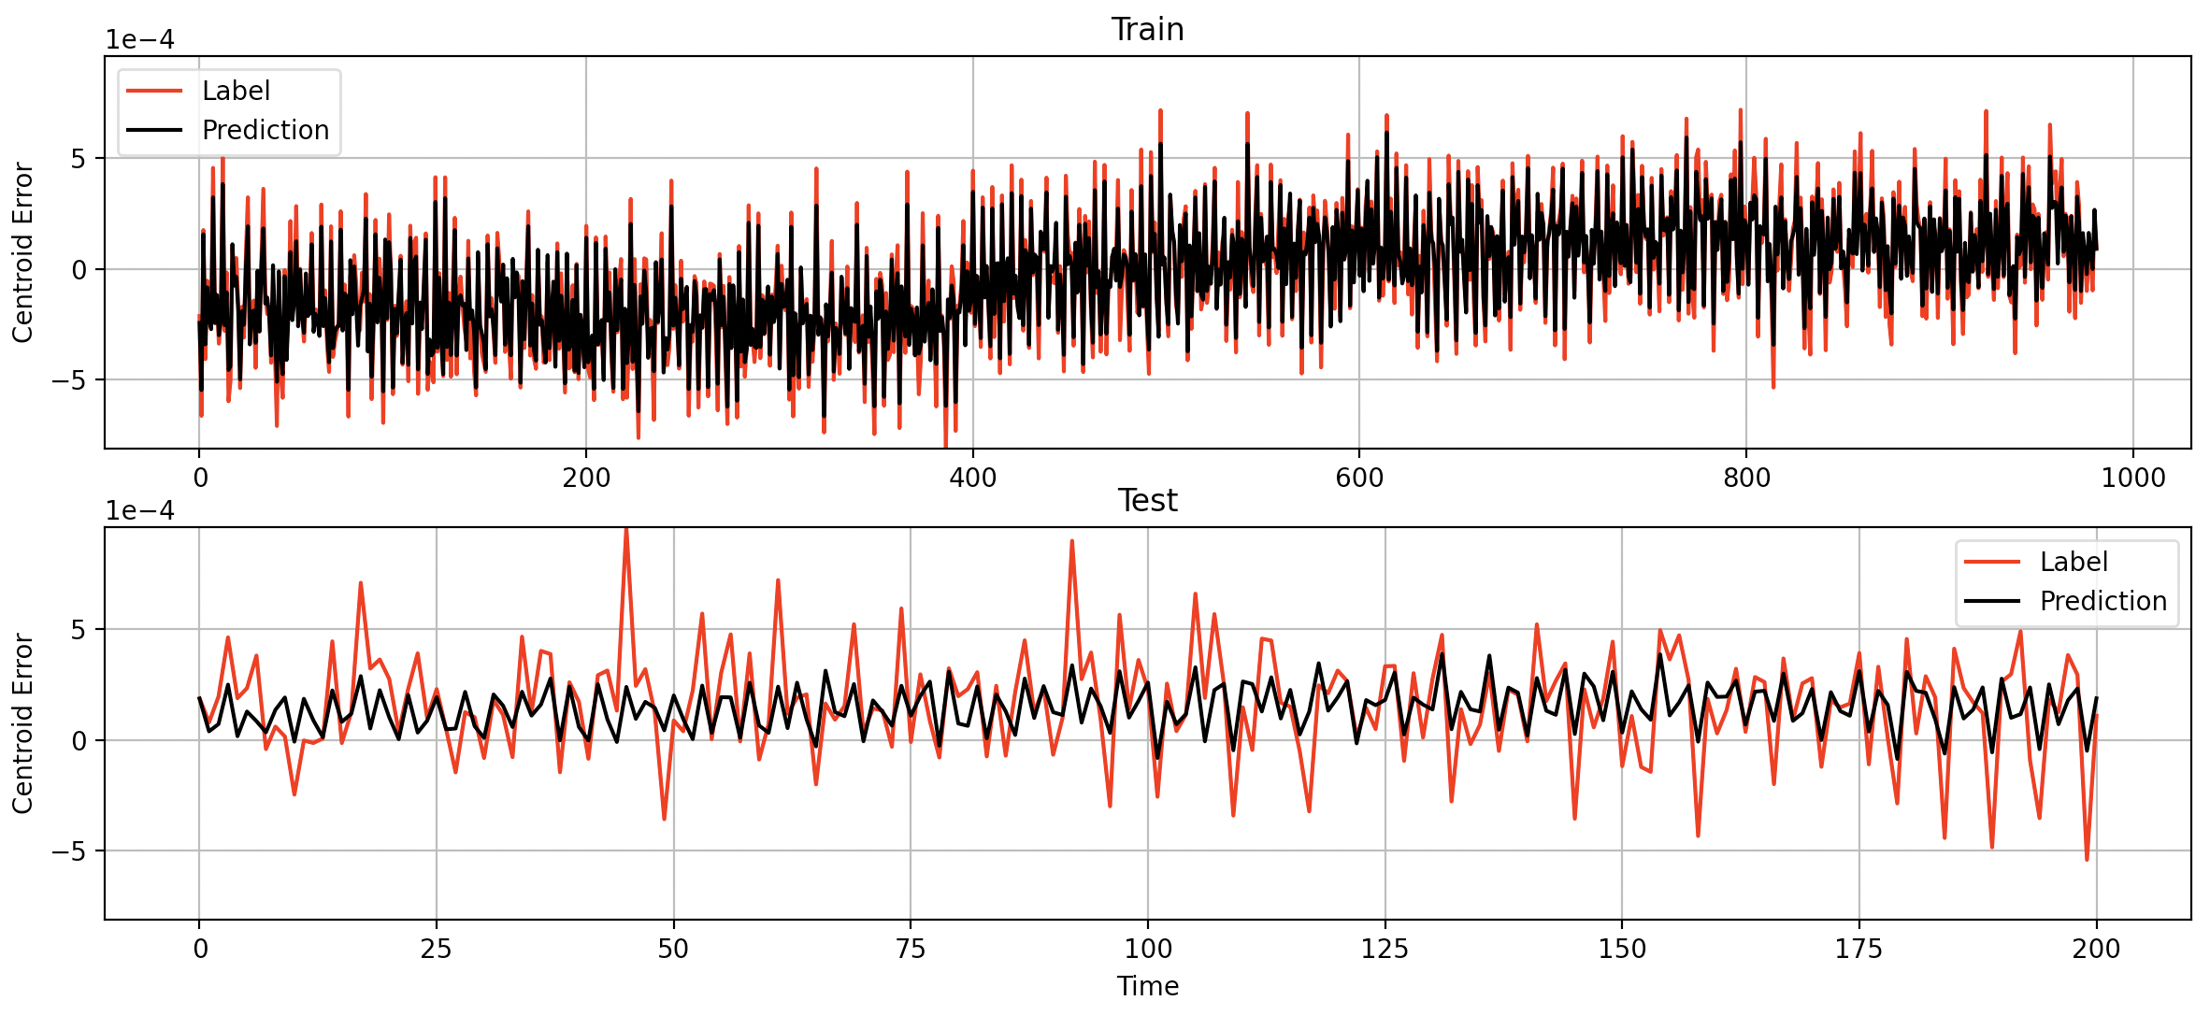
Results
OUT OF LOOP -----------> No feedback stabilization

Slide 11
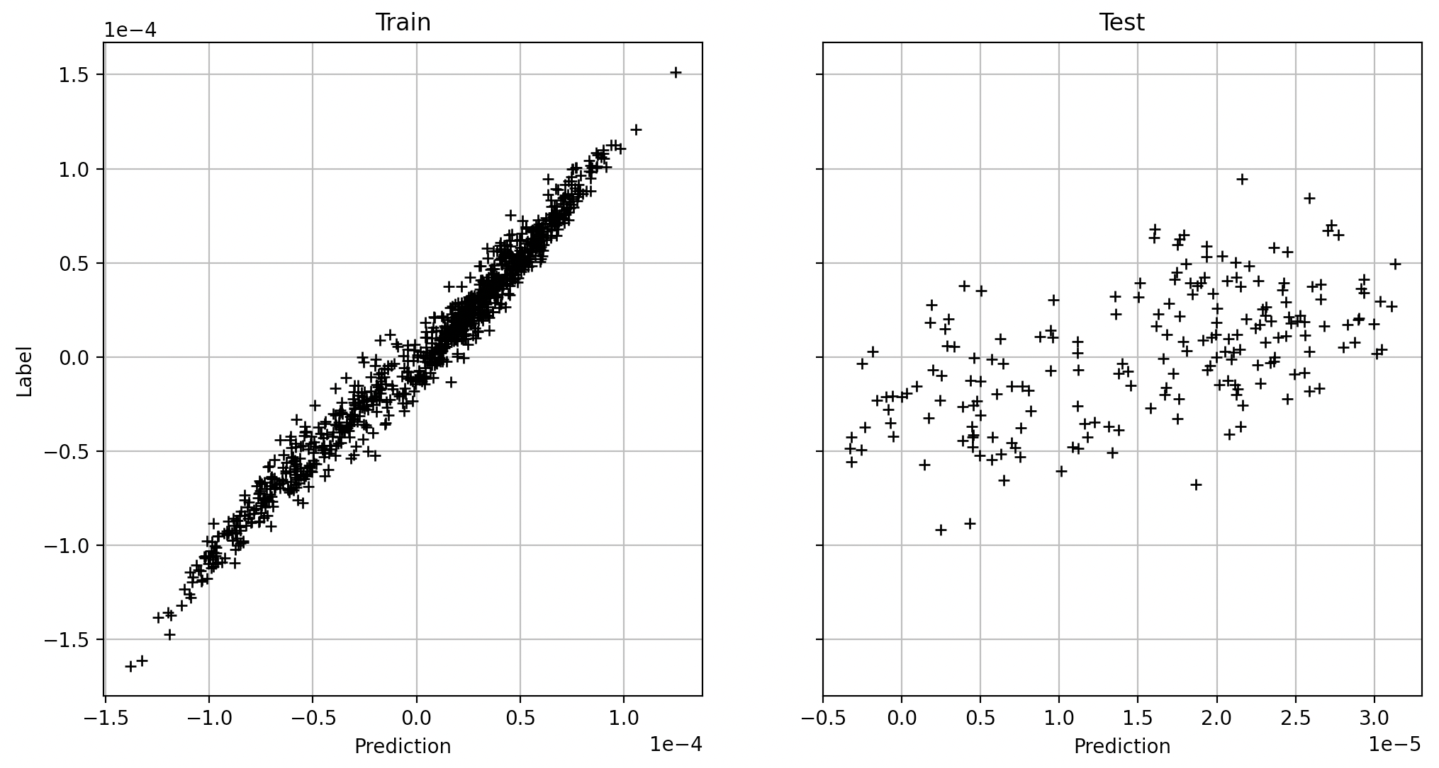
Results
IN LOOP -----------> Feedback stabilization

Slide 12
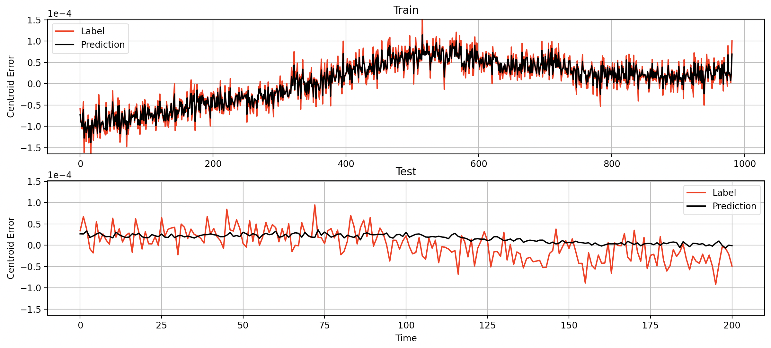
Results
IN LOOP -----------> Feedback stabilization

Slide 13
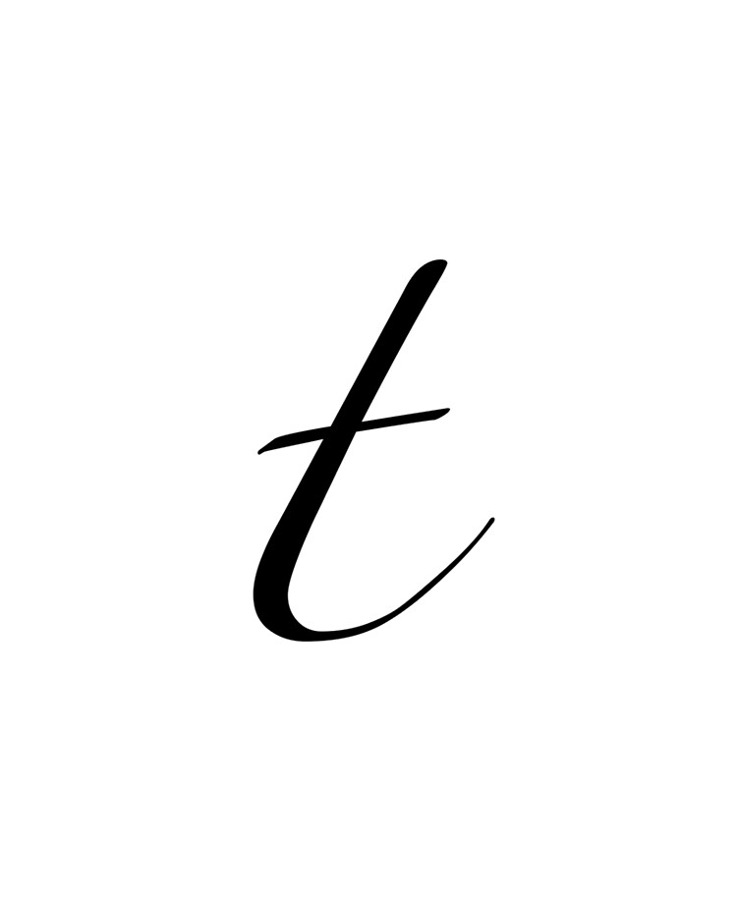

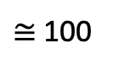
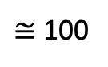
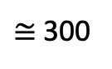
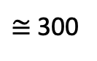
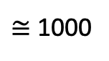
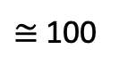
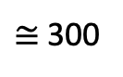
Conclusion & Next Steps
Training
Test
Currently:
$≅$ 1000
$≅$ 300
Training
Test
Training
Test
Training
Test
- Cross validation the dataset:
$≅$ 300
$≅$ 100
$≅$ 300
$≅$ 100
$≅$ 300
$≅$ 100

